Slide 1
Classes

Slide 2
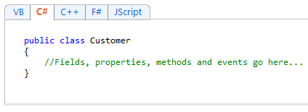
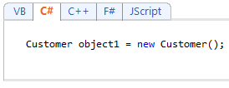
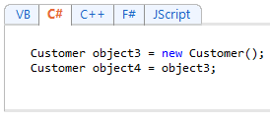
Link: http://msdn.microsoft.com/en-us/library/x9afc042.aspx

Slide 3
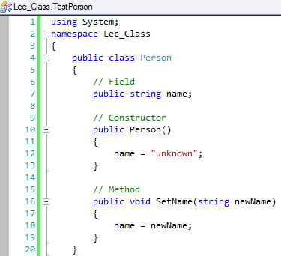
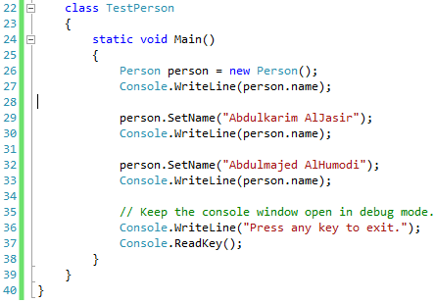

Slide 4
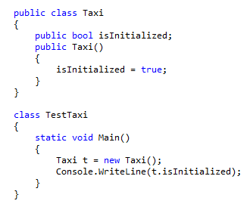
Constructors
Constructors are class methods that are executed when an object of a given type is created
Constructors have the same name as the class
Usually initialize the data members of the new object
A Constructor is invoked by the new operator immediately after memory is allocated for the new object

Slide 5
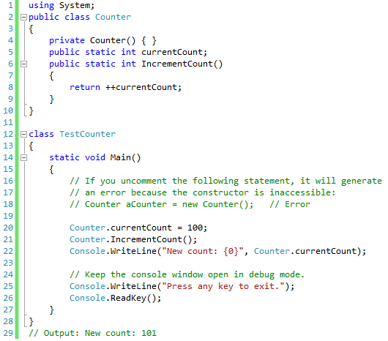

Slide 6
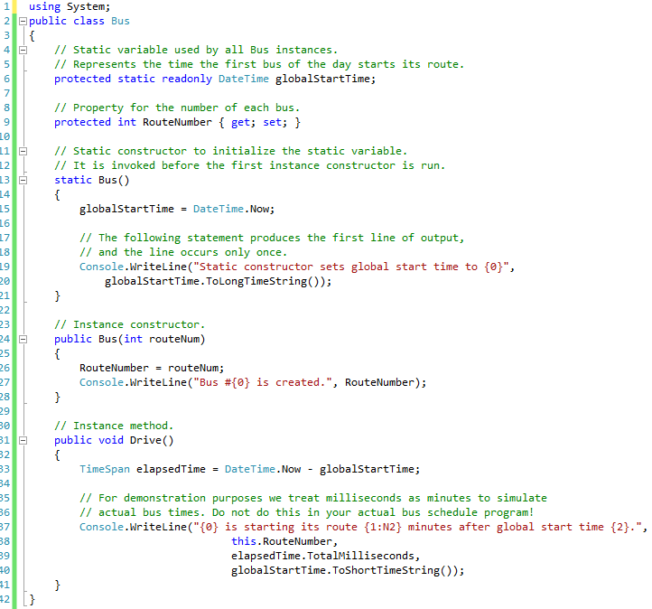

Slide 7
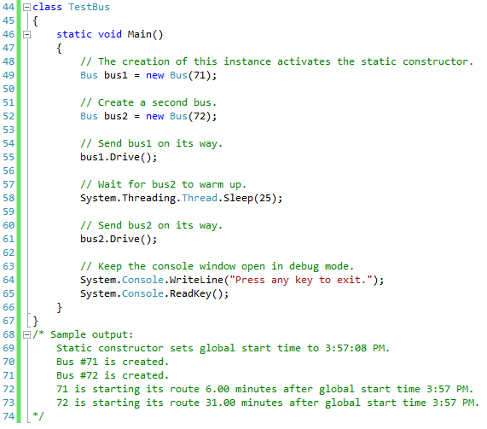

Slide 8
Static Members
A non-static class can contain static methods, fields, properties, or events
The static member is callable on a class even when no instance of the class has been created.
The static member is always accessed by the class name, not the instance name.
Only one copy of a static member exists, regardless of how many instances of the class are created.
Static methods and properties cannot access non-static fields and events in their containing type, and they cannot access an instance variable of any object unless it is explicitly passed in a method parameter.
It is more typical to declare a non-static class with some static members, than to declare an entire class as static.
Two common uses of static fields are to keep a count of the number of objects that have been instantiated, or to store a value that must be shared among all instances.
Static methods can be overloaded but not overridden, because they belong to the class, and not to any instance of the class.
Although a field cannot be declared as static const, a const field is essentially static in its behavior. It belongs to the type, not to instances of the type.
Therefore, const fields can be accessed by using the same Class Name. Member Name notation that is used for static fields. No object instance is required.
C# does not support static local variables (variables that are declared in method scope).
You declare static class members by using the static keyword before the return type of the member

