Slide 1
Object-Orientation Programming (OOP) البرمجة غرضية التوجيه

Slide 2
Contents:
Class
Class members
Class Methods
Objects
Constructor
Overridding
Inheritance

Slide 3
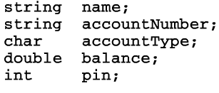
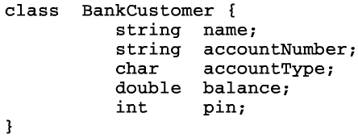
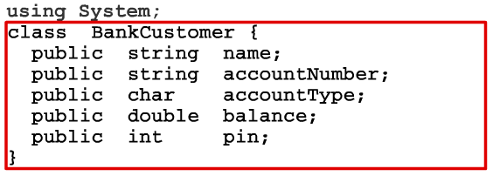

Slide 4
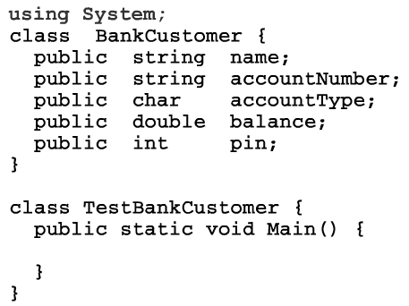
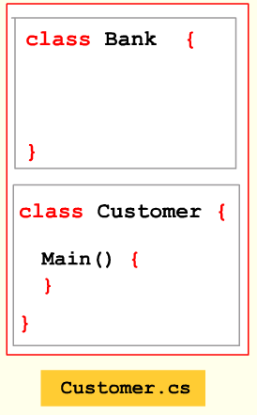
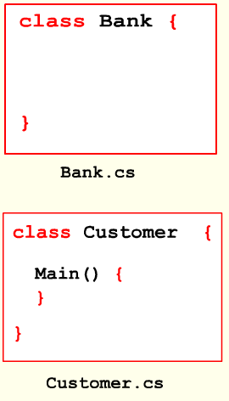
Link: http://www.joegrip.com/demos/csharp/obj-intro/start.html

Slide 5
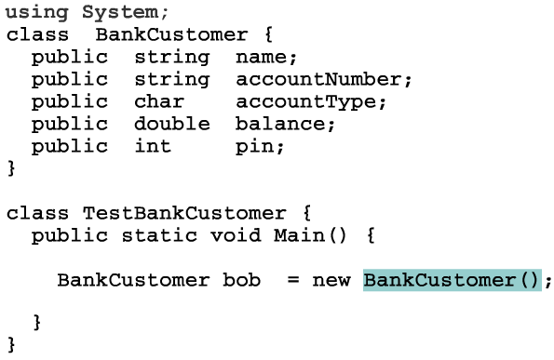
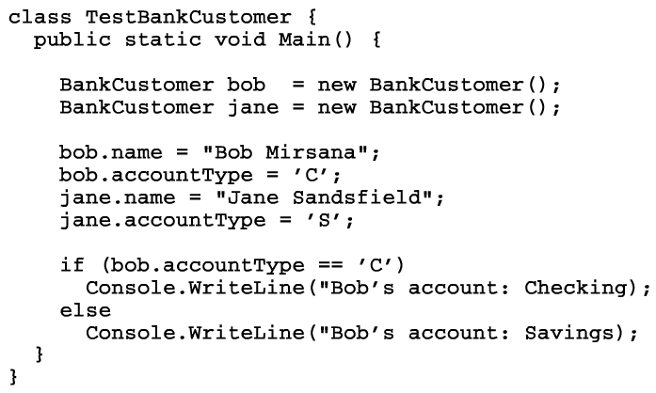

Slide 6
C# New Modifier
When should you use the new modifier on a method in a derived class in the C# language? The new modifier specifies that a method is supposed to hide a base method; it eliminates a warning issued by the compiler. In this article, we describe the new keyword.
Example
This program introduces two classes, A and B. The B class derives from the A class. Class A has a public method Y, while class B has a public method Y that uses the new keyword to hide the base method Y.
Main method description. The main entry point uses the A and B types. With ref1, the base class is used directly; this results in the A.Y method being used. With ref2, the base class is used with a derived class; this results in the A.Y method being used again. This is because the override keyword is not used on B.Y. With ref3, the derived class is used directly; the "new" method B.Y is thus used.

Slide 7
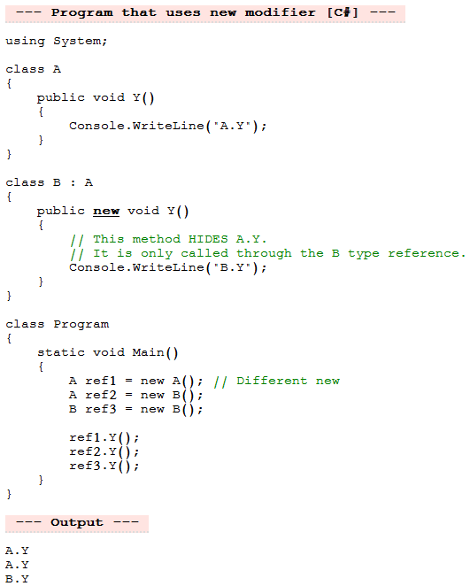

Slide 8
C# Override Method
You are working with classes that inherit from base classes in your C# program and want to specify that a method replaces a virtual base method. The override modifier provides a way for you to reimplement base methods. In this article, we introduce the override modifier through an example program.

Slide 9
Base & this keywords
using System;
class Net
{
public int _value = 6;
}
class Perl : Net
{
public new int _value = 7;
public void Write()
{
// Show difference between base and this.
Console.WriteLine(base._value);
Console.WriteLine(this._value);
}
}
class Program
{
static void Main()
{
Perl perl = new Perl();
perl.Write();
}
}
Class Net:
Contain one Class member is _value = 6
Class Perl:
The Net class is inherited
Contain one Class member is _value = 7
And one class method is Write()
Class Program:
Create an object of class Perl is perl
Then invoke Write() method

Slide 10
using System;
class Net
{
private int _value = 6;
internal int tValue(int v)
{
return _value = v;
}
}
class Perl : Net
{
public int _value = 7;
public void Write(int v)
{
// Show difference between base and this.
Console.WriteLine(base.tValue(v));
Console.WriteLine(this._value);
}
}
class Program
{
static void Main()
{
Perl perl = new Perl();
perl.Write(5);
}
}

Slide 11
Your First C# Program
Hello World
Why C#
C# Language Basics
Variables & Data Types
Decisions
Loops
Methods
Introduction to Objects
Overview
Methods & Constructors
Encapsulation
Think Objects
Strings
Arrays
Extending Classes & Objects
Method Overloading
Static
Object References
Inheritance
Constructors
Method Overriding
Structs
Abstract Classes
Interfaces
The Object Class
Method Parameters
C# Exceptions
Catching Exceptions
Exception Classes
Throwing Exceptions
Creating Exceptions
C# I/O
Console I/O
Streams
Binary File I/O
Text File I/O
Data Structures
Array of Objects
ArrayLists
HashTables
Namespaces & Assemblies
Program Structure
Windows Forms
Introduction to GUI Programming
Forms
GUI Components
Events
Visual Studio I (Creating Windows)
Visual Studio II (Adding Components & Events)
http://www.joegrip.com/csharp-course.html

